Slide 1

Operators in java

Slide 2
Operators in java
Operator in java is a symbol that is used to perform operations

Slide 3
Java Operator
Operator Type | Category | Precedence
Unary | postfix | expr++ expr--
 | prefix | ++expr --expr +expr -expr ~ !
Arithmetic | multiplicative | * / %
 | additive | + -
Shift | shift | << >>
Relational | comparison | < > <= >= instanceof
 | equality | == !=
Bitwise | bitwise AND | &
 | bitwise exclusive OR | ^
 | bitwise inclusive OR | |
Logical | logical AND | &&
 | logical OR | ||
Ternary | ternary | ? :
Assignment | assignment | = += -= *= /= %=

Slide 4
Java Unary Operator
class OperatorExample{
public static void main(String args[]){
int x=10;
System.out.println(x++);
System.out.println(++x);
System.out.println(x--);
System.out.println(--x);
}}
10
12
12
10

Slide 5
Shift Operator

Slide 6
Shift Operator
Left Shift (<<)
Right Shift (>>)

Slide 7
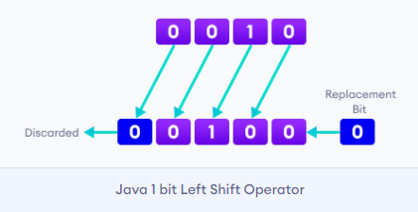
Left Shift Operator
Left shift operator shifts all bits towards the left by a certain number of specified bits.
It is denoted by <<.

Slide 8
Java Left Shift Operator Example
class OperatorExample{
public static void main(String args[]){
System.out.println(10<<2); //10*2^2=10*4=40
System.out.println(10<<3); //10*2^3=10*8=80
System.out.println(20<<2); //20*2^2=20*4=80
System.out.println(15<<4); //15*2^4=15*16=240
}}

Slide 9
Right Shift Operator
Right shift operator shifts all bits towards the right by a certain number of specified bits.
It is denoted by >>.
When we shift any number to the right, the least significant bits (rightmost) are discarded and the most significant position (leftmost) is filled with the sign bit.

Slide 10
Java Right Shift Operator Example
class OperatorExample{
public static void main(String args[]){
System.out.println(10>>2); //10/2^2=10/4=2
System.out.println(20>>2); //20/2^2=20/4=5
System.out.println(20>>3); //20/2^3=20/8=2
}}

Slide 11
Relation operators

Slide 12
Relation operators
Used to test comparison between operands or values.
Can be use to test whether two values are equal or not equal or less than or greater than etc.
Returns the Boolean results, i.e. true or false after the comparison

Slide 13
Operator | Description
== | Check if two operand are equal
!= | Check if two operand are not equal.
> | Check if operand on the left is greater than operand on the right
< | Check operand on the left is smaller than right operand
>= | check left operand is greater than or equal to right operand
<= | Check if operand on left is smaller than or equal to right operand

Slide 14
Example
int a, b;
a=40;
b=30;
System.out.println("a == b = " + (a == b) );
System.out.println("a != b = " + (a != b) );
System.out.println("a > b = " + (a > b) );
System.out.println("a < b = " + (a < b) );
System.out.println("b >= a = " + (b >= a) );
System.out.println("b <= a = " + (b <= a) );

Slide 15
Bitwise operators

Slide 16
Bitwise operators
Bitwise operators are used to perform operations bit by bit.
Java defines several bitwise operators that can be applied to the integer types long, int, short, char and byte.

Slide 17
Operator | Description
& | Bitwise AND
| | Bitwise OR
^ | Bitwise exclusive OR
<< | left shift
>> | right shift

Slide 18
truth table for bitwise &, | and ^
a | b | a & b | a | b | a ^ b
0 | 0 | 0 | 0 | 0
0 | 1 | 0 | 1 | 1
1 | 0 | 0 | 1 | 1
1 | 1 | 1 | 1 | 0

Slide 19
Bitwise OR Operator
12 = 00001100 (In Binary)
25 = 00011001 (In Binary)
Bitwise OR Operation of 12 and 25
00001100
| 00011001
____________
00011101 = 29 (In Decimal)

Slide 20
Program 1
class Main {
public static void main(String[] args) {
int number1 = 12, number2 = 25, result;
result = number1 | number2;
System.out.println(result); // prints 29
}
}

Slide 21
Bitwise AND Operator
12 = 00001100 (In Binary)
25 = 00011001 (In Binary)
// Bitwise AND Operation of 12 and 25
00001100
& 00011001
____________
00001000 = 8 (In Decimal)

Slide 22
Program
class Main {
public static void main(String[] args) {
int number1 = 12, number2 = 25, result;
// bitwise AND between 12 and 25
result = number1 & number2;
System.out.println(result); // prints 8
}
}

Slide 23
Bitwise XOR Operator
12 = 00001100 (In Binary)
25 = 00011001 (In Binary)
// Bitwise XOR Operation of 12 and 25
00001100
^ 00011001
____________
00010101 = 21 (In Decimal)

Slide 24
Program
class Main {
public static void main(String[] args) {
int number1 = 12, number2 = 25, result;
// bitwise XOR between 12 and 25
result = number1 ^ number2;
System.out.println(result); // prints 21
}
}

Slide 25
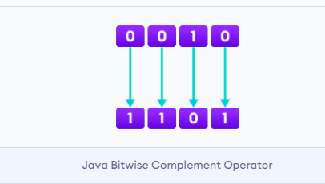
Bitwise Complement Operator
Bitwise complement operator is a unary operator (works with only one operand).
It is denoted by ~.
It changes binary digits 1 to 0 and 0 to 1.

Slide 26
The bitwise complement of any integer N is equal to - (N + 1).
For example,
Consider an integer 35.
As per the rule, the bitwise complement of 35 should be -(35 + 1) = -36.

Slide 27
Program
class Main {
public static void main(String[] args) {
int number = 35, result;
// bitwise complement of 35
result = ~number;
System.out.println(result); // prints -36
}
}

Slide 28
Logical Operators

Slide 29
Logical operators
Logical operators are used to check whether an expression is true or false.
They are used in decision making.

Slide 30
Operator | Example | Meaning
&& (Logical AND) | expression1 && expression2 | true only if both expression1 and expression2 are true
|| (Logical OR) | expression1 || expression2 | true if either expression1 or expression2 is true
! (Logical NOT) | !expression | true if expression is false and vice versa

Slide 31
class Main {
public static void main(String[] args) {
// && operator
System.out.println((5 > 3) && (8 > 5)); // true
System.out.println((5 > 3) && (8 < 5)); // false
// || operator
System.out.println((5 < 3) || (8 > 5)); // true
System.out.println((5 > 3) || (8 < 5)); // true
System.out.println((5 < 3) || (8 < 5)); // false
// ! operator
System.out.println(!(5 == 3)); // true
System.out.println(!(5 > 3)); // false
}
}

Slide 32
Java Ternary Operator
The ternary operator (conditional operator) is shorthand for the if-then-else statement.
variable = Expression ? expression1 : expression2
If the Expression is true, expression1 is assigned to the variable.
If the Expression is false, expression2 is assigned to the variable.

Slide 33
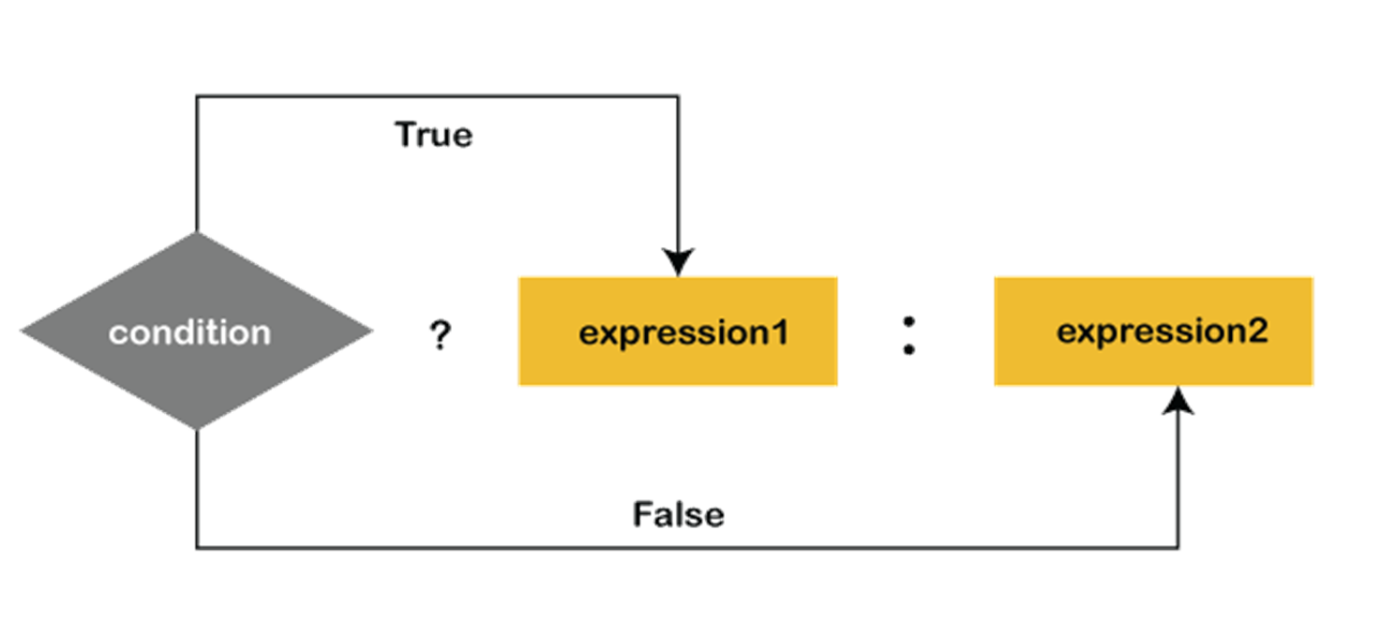

Slide 34
Example
int time = 20;
String result = (time < 18) ? "Good day." : "Good evening.";
System.out.println(result);

